Slide 1
IntelliOverflow
Ryan Green

Slide 2
Project Deliverable
IntelliOverflow – Visual Studio IDE Plugin
In-app Stack Overflow search and browser
Recommend Stack Overflow posts to resolve errors/warnings/messages
Compatible with any programming language in Visual Studio
Standalone API – Dynamically Linked Library (DLL)
Interface with StackExchange API, send data back to client (IDE Plugin)
Plugins for multiple IDEs using same underlying framework

Slide 3

Purpose and Motivation
Domain experts (mathematicians, scientists, researchers) may need code
Simulations
Analyzing data
Assisting algorithms
Do not have expertise/theory of Software Engineer
Plugin to help bridge the gap and resolve issues based on compiler and runtime errors, warnings, and messages
Assist knowledgeable developers with quick, in-app solutions
Speed up bug fixing, add convenience
Developing on one monitor

Slide 4
Implementation – Standalone API
C# using .NET Framework 4.7.2
Asynchronous
Newtonsoft Json.NET to parse json data
Interface with public StackExchange API
Send API calls over HTTP (search query, obtain post data)
StackExchange API returns GZIP-compressed json data
Decompress and parse json into C# objects
Send C# objects back to program implementing DLL
Post filtering and ranking

Slide 5
Implementation – IDE Plugin
C# using Visual Studio SDK (VSSDK)
UI Comps use Windows Presentation Foundation (WPF) → XAML
<ItemsControl Grid.Column="2" Grid.Row="2" ItemsSource="{Binding Path=Tags}" …
<ItemsControl.ItemsPanel>
<ItemsPanelTemplate>
<StackPanel Orientation="Horizontal"/>
</ItemsPanelTemplate>
</ItemsControl.ItemsPanel>
<ItemsControl.ItemTemplate>
<DataTemplate>
<TextBlock Text="{Binding StringFormat='\{0\}, '}" Foreground="DarkGray"/>
</DataTemplate>
</ItemsControl.ItemTemplate>
</ItemsControl>

Slide 6
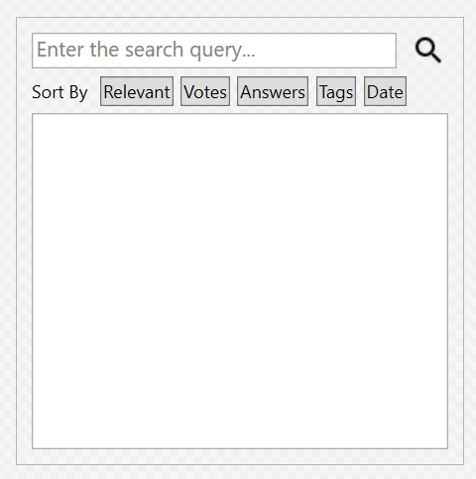
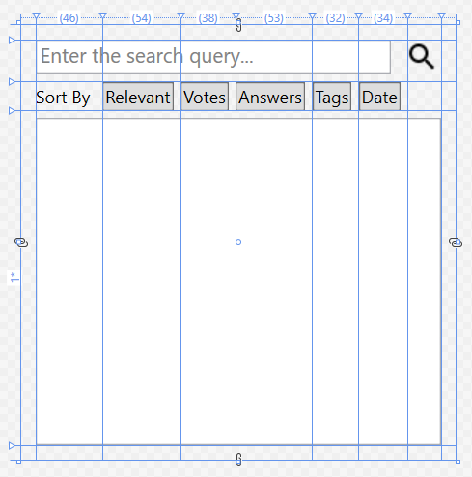

Slide 7
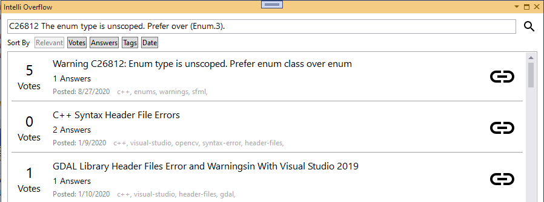
Implementation – IDE Plugin Components
IntelliOverflow Tool Window (move, resize, dock)
Stack Overflow in-app browser Tool Window (WebView)
Error List “Search on Stack Overflow” Command

Slide 8
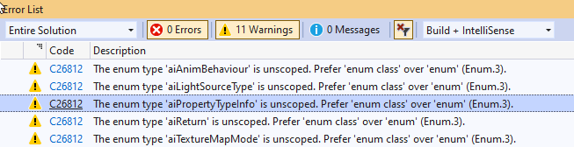
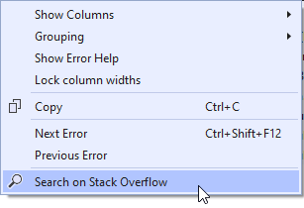
Error List Search
Error Code: C26812
Error Text: The enum type ‘aiPropertyTypeInfo’ is unscoped…
Strip context of error text
Search Stack Overflow for:
C26812
The enum type is unscoped…
The enum type ‘aiPropertyTypeInfo’ is unscoped…
C26812: The enum type is unscoped…
Combine, Filter, and Rank resulting posts

Slide 9
Demo

Slide 10
Evaluation
Recommends useful posts in my testing
Hard to find realistic errors in existing projects
Fabricate errors
Need to perform actual study for a tool like this
Issue with broad errors (NullReference)
Test run while working on another course project
Potential future test run at work

Slide 11
Challenges
Newcomer to IDE plugin development
VSSDK is very undocumented
Rely on archived developer forums from 2007
Sending error to plugin
Limitations in WPF capability for UI
StackExchange API limits searching
Compatibility between DLL and plugin
Initial scoping issues

Slide 12
Future Work
Plugins targeting other IDEs (Eclipse, JetBrains)
Use NLP when ranking post relevancy (tags, programming language)
User can login to Stack Overflow through plugin
Offline mining of Stack Overflow archive
Expand query construction for different use cases

